Slide 1
Comparing Average Heart Rate Between Author’s VR Boxing and Brazilian Jiu-Jitsu Workouts
By Matt Haffner
Metropolitan State University

Slide 2
Overview
Purpose
Compare average intensity of my workouts
2 Types of Workouts
Virtual Reality (VR) Boxing
Brazilian Jiu Jitsu (BJJ) Sparring
Hypothesis
Average intensity for VR Boxing is higher than BJJ
Methodology
Average intensity measured by Average Heart Rate via Apple Watch

Slide 3

About the Author
Works at Minnesota Martial Arts Academy
Coaches Brazilian Jiu Jitsu

Slide 4
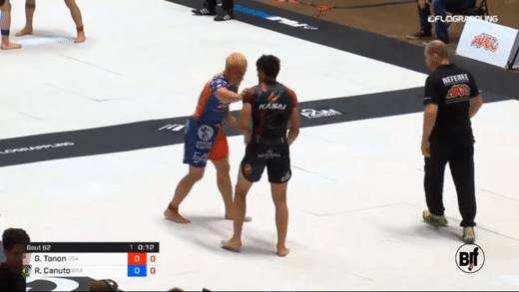
Brazilian Jiu-Jitsu
Sport & Martial art similar to Wrestling or Judo
More focused on submissions
Created @ gifrun.com from:
https://www.youtube.com/watch?v=YCTBgs1XvSg

Slide 5
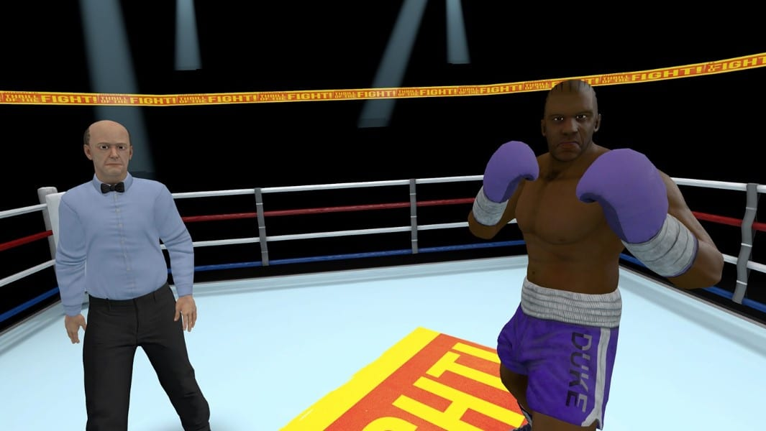
Virtual Reality Boxing
Game:
Thrill of the Fight
Plays like a boxing match
Platform:
Meta Quest 2
Source: https://www.oculus.com/experiences/quest/3008315795852749

Slide 6
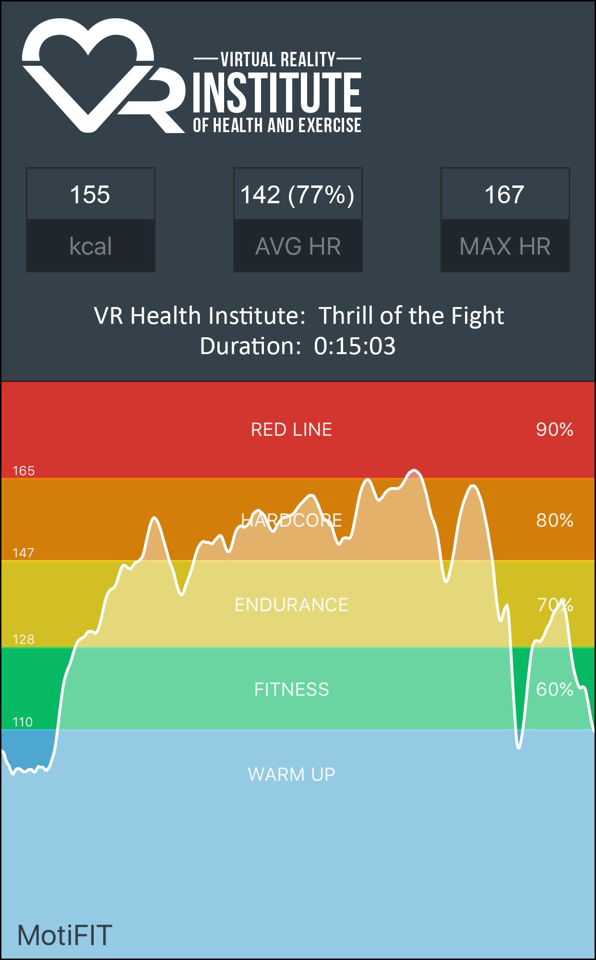
Virtual Reality Exercise
Virtual Reality Institute of Health & Exercise
Ranks intensity of various VR games
Thrill of the Fight ranks #2
Equivalent intensity of Rowing
#1 unmodified game
Source: https://vrhealth.institute/portfolio/thrill-of-the-fight/

Slide 7
Hypothesis
H₀: μ_{BJJ} = μ_{Boxing}
H_{a}: μ_{BJJ} < μ_{Boxing}
μ_{BJJ} is the average heart rate for Brazilian Jiu Jitsu workout
μ_{Boxing} is the average heart rate for Virtual Reality Boxing workout

Slide 8
Procedure - Data Collection
Heart Rate Data Collected with Apple Watch (Series 6 - 44mm)
Via Apple Fitness App
Collect 30 minutes of data
No Warm up
Typical Exercise Structure
BJJ - 5 minutes on / 1 minute off
VR Boxing - 3 minutes on / 1 minute off
BJJ training partners were informed about study / wearing a watch

Slide 9
Procedure - Data Analysis
14 Data Points
7 BJJ
7 VR Boxing
Data Analysis
Data collected from Apple Fitness App and put into Excel File
Data imported to R Studio
Graphed with ggplot2 package
Paired T-Test
Exploratory linear regression on Avg Hr vs. Duration

Slide 10
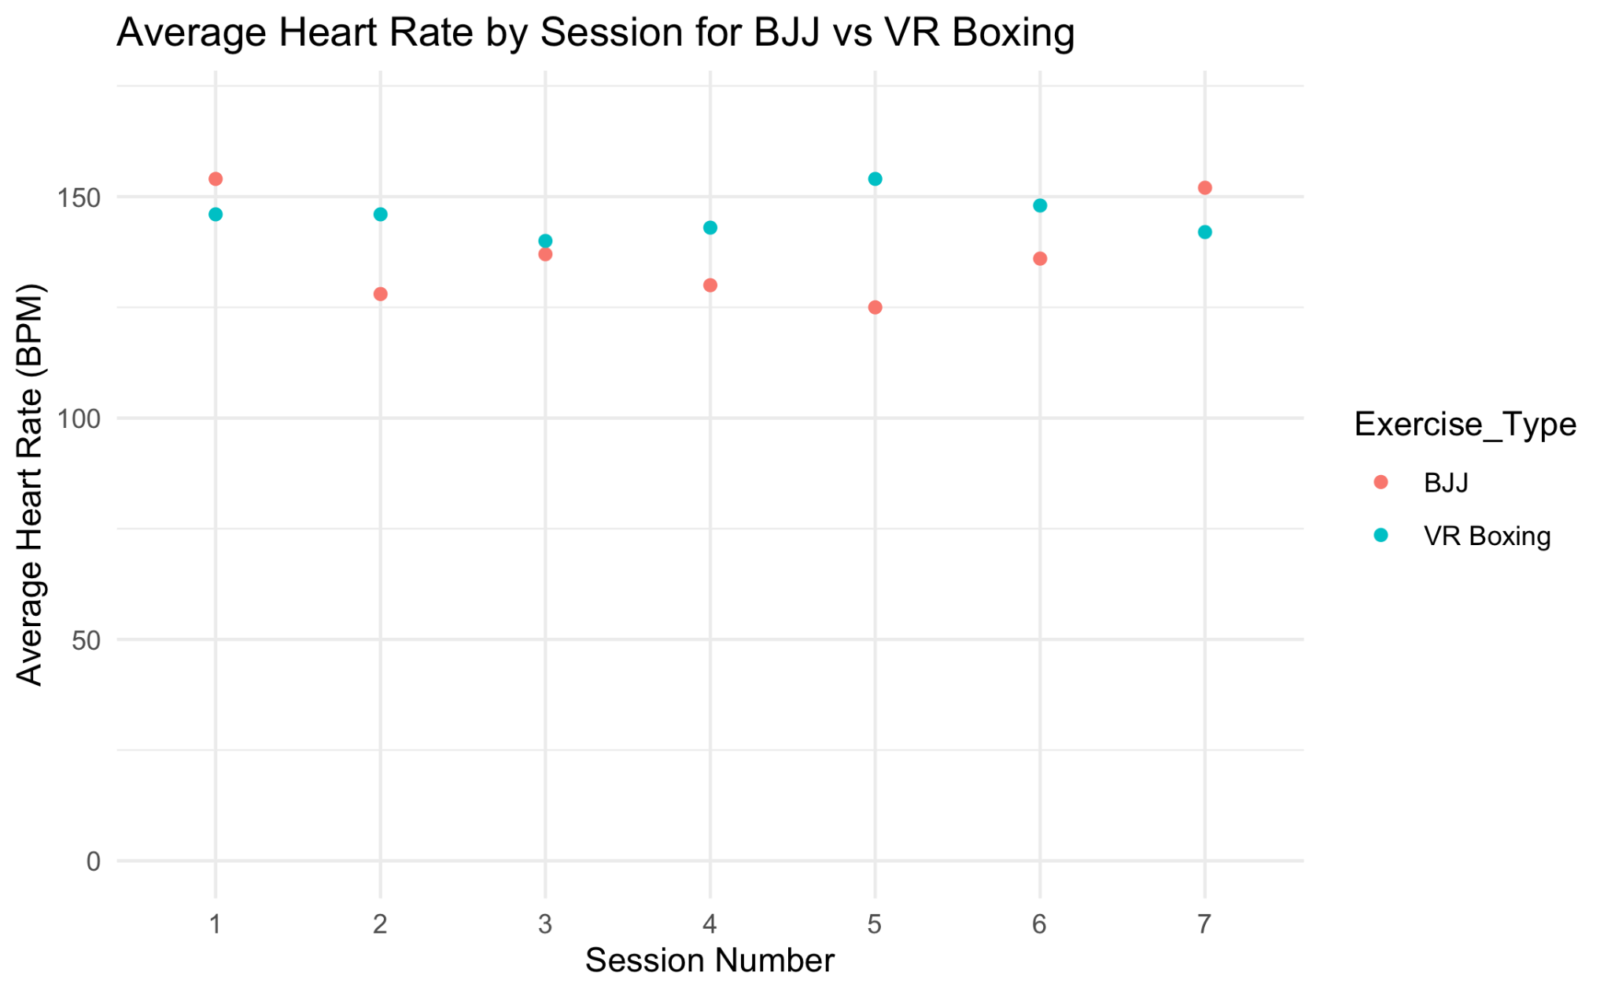
Results - Data Points

Slide 11
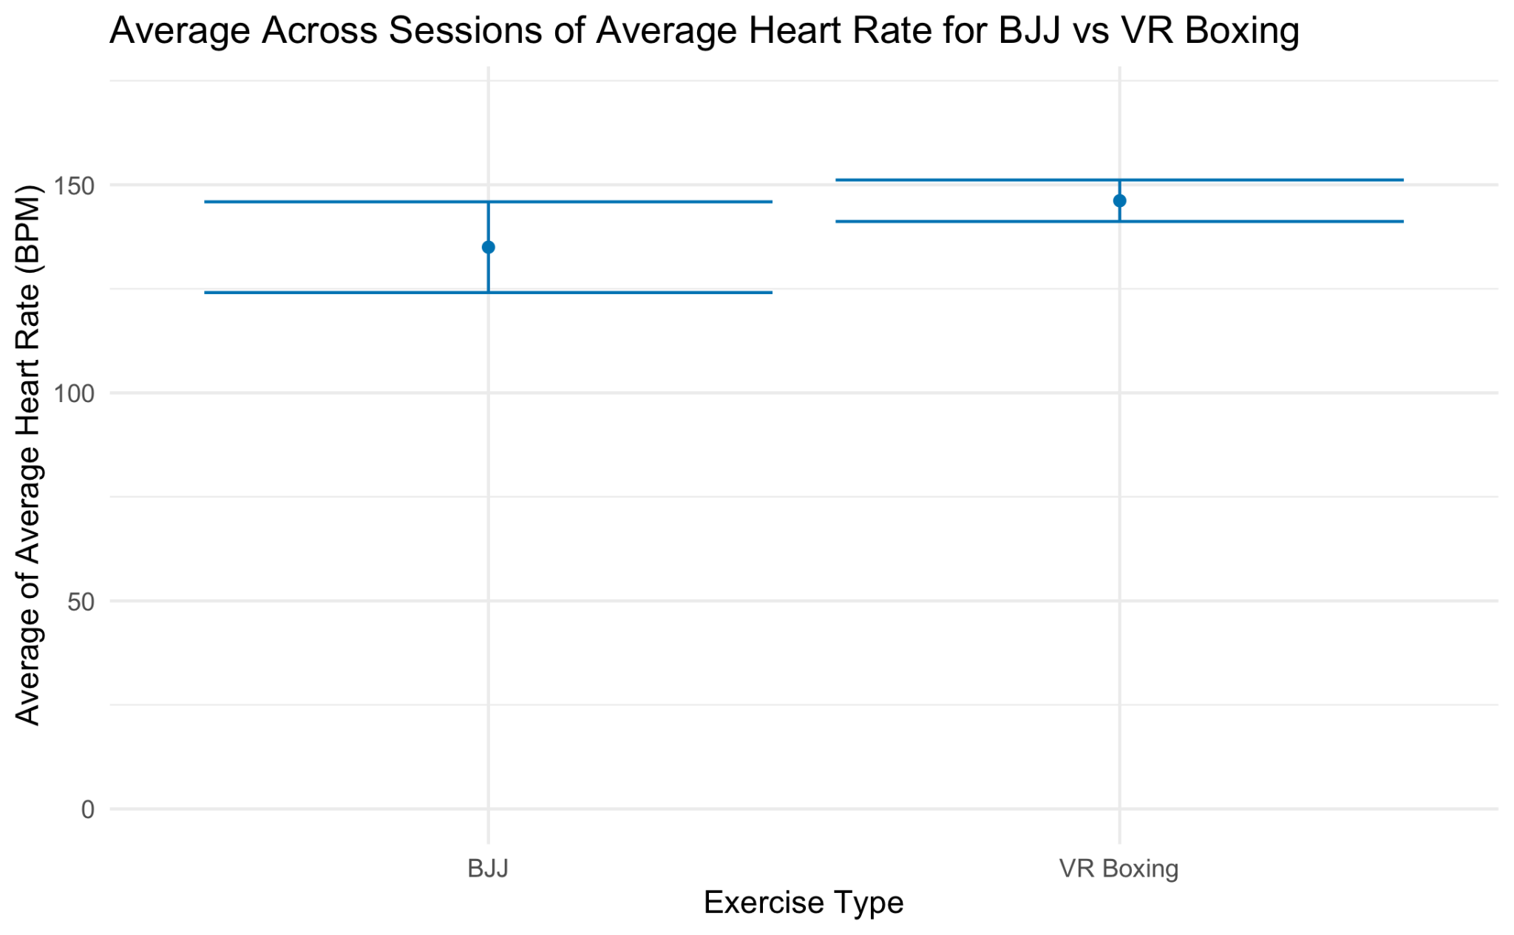
Results - Average of Average Heart Rate

Slide 12
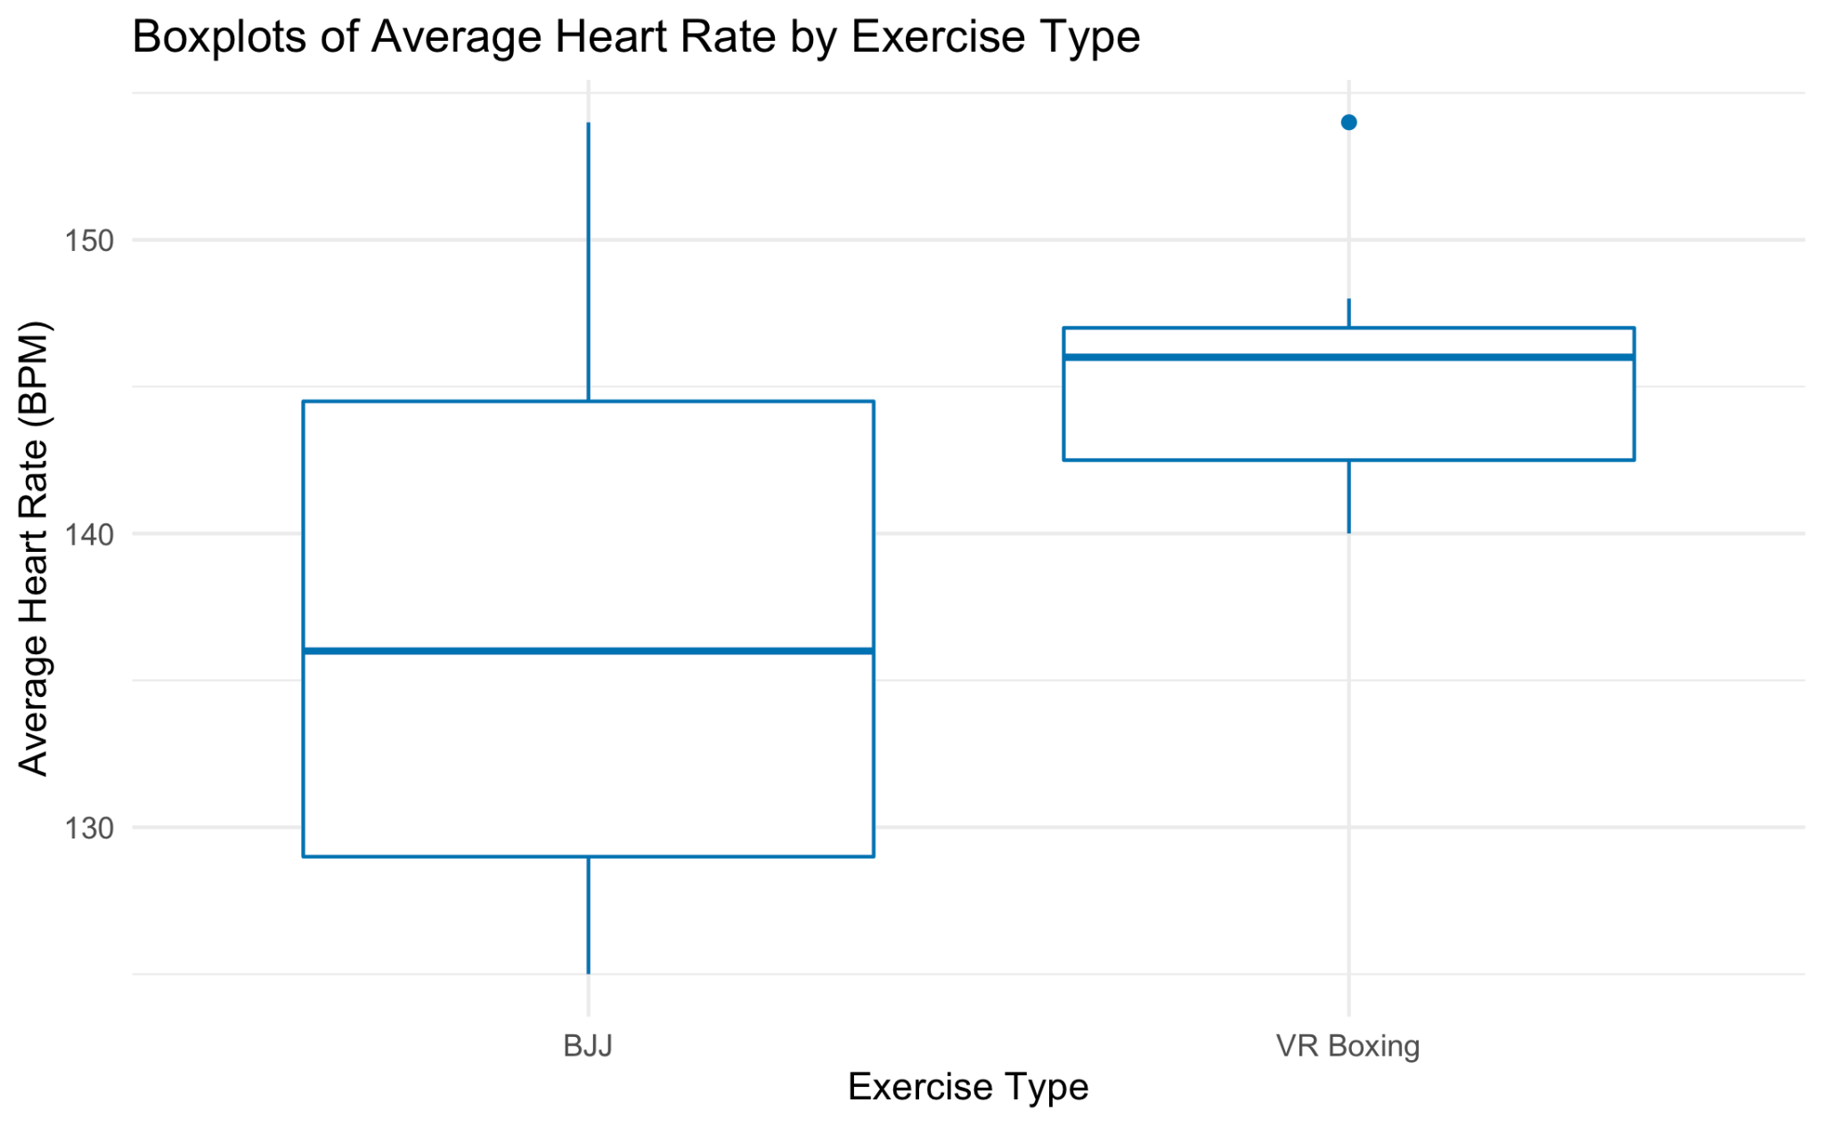
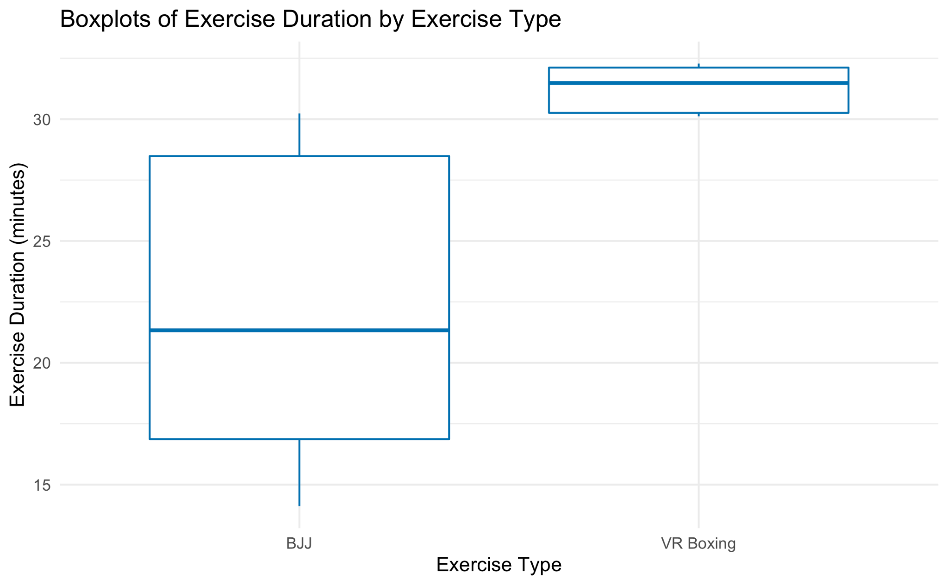
Results - Distributions

Slide 13
Results - Data Analysis
Paired T Results
p = 0.088
t = -1.5318
Decision
p > 0.05
Fail to reject the null hypothesis
There is not sufficient evidence to support the claim that the average heart rate of a BJJ workout is less than a VR boxing workout for the author
Exploratory Linear Regression
Duration and Avg HR positively correlated between exercise types (p = 0.00284, r = 0.73)
Correlation not significant within either exercise group
BJJ (p = 0.0825, r = 0.70)

Slide 14
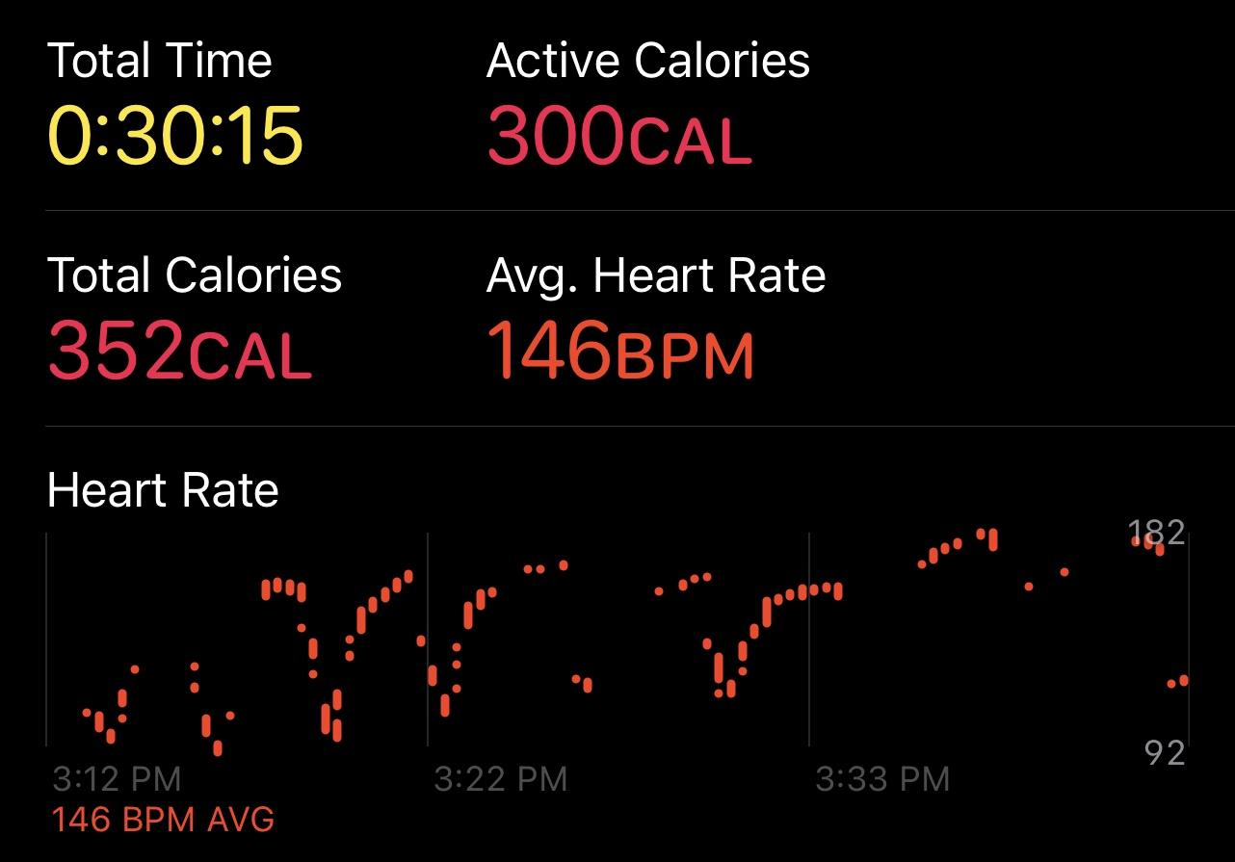
Problems with Study
Problems with HR tracking
Gaps in data
Pauses
Accuracy?
Low sample size (n = 14 / 2)
Not clear if normal distribution
Watch changed BJJ behavior
Bugs with VR device
From Apple Fitness app

Slide 15
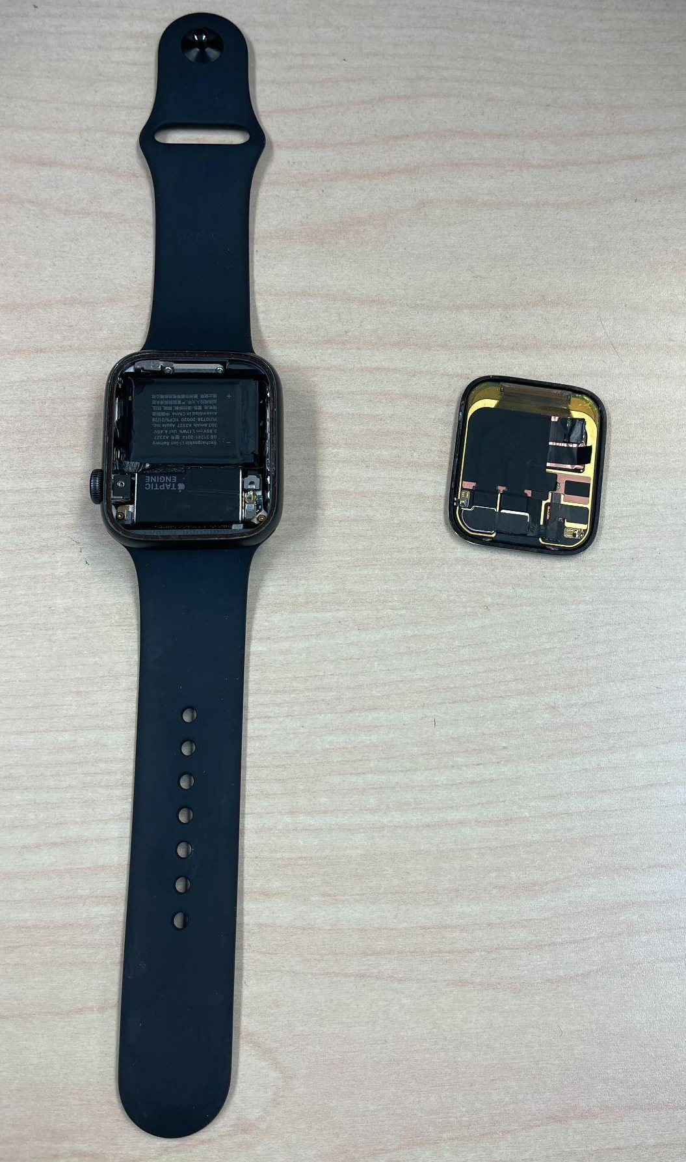
Problems with Study
Technical problem #4

Slide 16
Discussion
Need more data for a concrete conclusion
Use a more appropriate and better heart rate monitor
Keep duration the same
BJJ appeared to have a much larger distribution of average heart rates
Likely partially due to shorter duration of data collected
VR Boxing small distribution of average heart rate
Github repository:
https://github.com/mrhaffner/ds_hr_project

